Slide 1



Driving Performance: Maximizing
the Value of Compensation Planning
The Competitive Edge of Informed Compensation Strategies

Slide 2


NFPay Webinar 2026
Welcome
Julie Thompson
Director of Learning and Capacity Building
Lynn Cameron
Co-founder, Managing Partner

Slide 3
NFPay Webinar 2026
The Importance of
Understanding Compensation Trends
  Attract and Retain Talent: Competitive compensation practices enable organizations to attract skilled professionals and retain top talent, ensuring continuity and stability in service delivery.
  Market Positioning and Competitiveness: By benchmarking compensation against industry standards, organizations can ensure they remain competitive in the marketplace, enhancing their attractiveness to prospective employees while maintaining parity with peer organizations.
  Employee Satisfaction and Engagement: Aligning compensation with market norms fosters a sense of fairness and equity among employees, promoting higher levels of job satisfaction, engagement, and productivity.
  Strategic Resource Allocation: Insights from compensation surveys inform strategic resource allocation, allowing organizations to optimize their budgetary allocations to attract and retain talent effectively while ensuring fiscal responsibility and organizational sustainability.
  Compliance and Risk Mitigation: Regularly assessing compensation practices helps organizations remain compliant with relevant labor laws and regulations, mitigating the risk of legal issues and ensuring ethical and fair treatment of employees

Slide 4
NFPay Webinar 2026
Why OASIS partnered with BenchMarket
  BenchMarket brings expertise in compensation data and analysis. This gives you reliable results tailored to the developmental services sector.
  The partnership makes annual surveys affordable and sustainable. OASIS can now provide sector pay data every year instead of occasional large studies.
  You gain access to broader comparison data across sectors. This supports better budgeting, bargaining, and pay decisions.
  More agencies participating means stronger evidence and more defensible decisions.
  The submission process is simple through an online portal. Once your data is entered, future years take far less effort and the dataset becomes more useful over time.

Slide 5
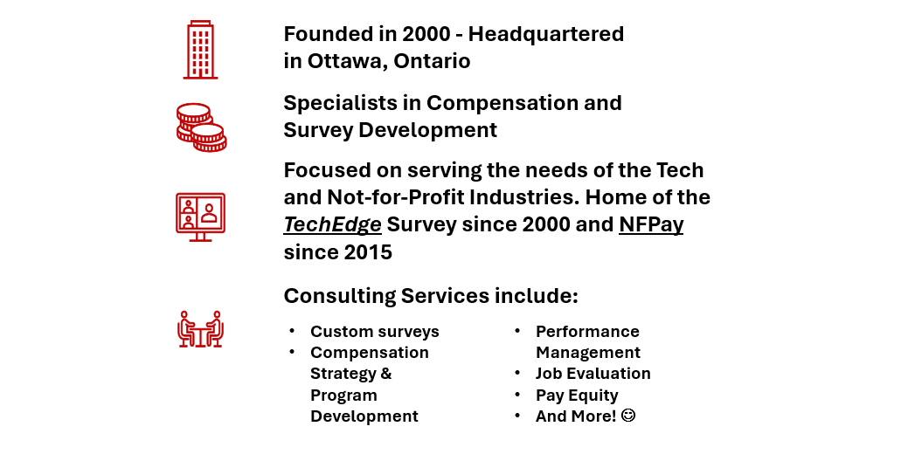
NFPay Webinar 2026
BenchMarket – who are we?
Check us out at www.benchmarket.ca

Slide 6
NFPay Webinar 2026
Introduction to NFPay
Who is included?
  Associations, Foundations, Societies, Councils
  Social Enterprises, Community groups
  Charities (Public and Private)
  Government Funded Agencies
  All other Not-for-Profits
Survey Design
  A–Z job families – from entry level to ED/CEO
  Broad range of statistics – 10th to 90th Percentile; Base salary, Bonus and Total Cash Compensation
  A comprehensive HR Programs report including, Bonus Design, Wellness Programs and more. Included in 2025
  Data segmented by type of NFP, Geography and by Operating Budget
•Simple & easy to understand format with supporting job and level descriptions
•Submission and data interpretation support

Slide 7
NFPay Webinar 2026
Questionnaire
Demographics & Scoping Factors
What type of NFP Organization?
•Choose – “Registered Charity”
What is the Focus of your NFP?
•Choose – “Social Services - Developmental Services”

Slide 8
NFPay Webinar 2026
Visual Walk-Through of Submission Process
Visual of submission
  Username & Passcode – provided by email after registration
  Salary Data Template
•Example of job matching – job families and job levels
•Non-Unionized - Focus on raw data – all employees that can be job matched
•Unionized – Focus on Collective Agreements – Job & Salary Steps
•Demographics & HR Programs
•Save and Continue feature
BenchMarket will review the submission and contact you with any questions

Slide 9
NFPay Webinar 2026
NFPay Report 2025
Visual walk-through of Report
  Examples of salary data and how the data is presented
  Example of the demographics section
  Example of the HR Programs report questionnaire

Slide 10
NFPay Webinar 2026
How An OASIS Member Uses NFPay in HR Planning*
Annual Workforce Planning Cycle
Example adapted from Lanark Community Alliance (Amanda Matheson, 2024)
→ Pay Philosophy (Lead/Match/Lag)
  Uses NFPay as the primary external benchmark (50th percentile target – Match)
→ Internal Ranges
  Builds internal salary ranges based on market data
→ Employee Mapping
  Maps employees to ranges and calculates compa-ratios (salary/midpoint)
→ Gap Analysis
  Identifies pay gaps and retention risks
→ Budget & Strategy
  Uses findings to inform budget planning, board discussions, and bargaining strategy

Slide 11
NFPay Webinar 2026
January’s Feedback Survey
Data Collection Process:
  Union Data – add Overtime and Types of Bonuses to submission template
  Add Details about Negotiated contracts to HR Questionnaire
  Non – Union - add Average Bonus to reports
  Add “International Focus” to submission template
  Revised Kitchen Services/Cook job capsule
  Add Environmental Specialist job capsule
Submission Timeline:
  Participants can pick the best month of the year to submit/update their data
  Submission will be due at the end of the chosen month
  Rolling Database concept allows for flexibility and leveled workflow
  Optimal month to receive NFPay Reports – end of February – starts in 2027
  Next Edition will be published late June 2026

Slide 12
Next Steps and Q&A
  Difference between submission for Union vs Non-Union employees.
  Why HR Programs is only every other year
NFPay Webinar 2026

Slide 13
Thank you

